Slide 1
Comparing several means: ANOVA (GLM 1)
Chapter 11

Slide 2
When And Why
When we want to compare means we can use a t-test. This test has limitations:
You can compare only 2 means: often we would like to compare means from 3 or more groups.
It can be used only with one Predictor/Independent Variable.

Slide 3
When And Why
ANOVA
Compares several means.
Can be used when you have manipulated more than one Independent Variables.
It is an extension of regression (the General Linear Model)

Slide 4
Why Not Use Lots of t-Tests?
If we want to compare several means why don’t we compare pairs of means with t-tests?
Can’t look at several independent variables.
Inflates the Type I error rate.
1
1
2
Vs
1
3
Vs
2
3
2
Vs
3

Slide 5
Type 1 error rate
Formula = 1 – (1-alpha)^{c}
Alpha = type 1 error rate = .05 usually (that’s why the last slide had .95)
C = number of comparisons
Familywise = across a set tests for one hypothesis
Experimentwise = across the entire experiment

Slide 6
Regression v ANOVA
ANOVA in Regression:
Used to assess whether the regression model is good at predicting an outcome.
ANOVA in Experiments:
Used to see whether experimental manipulations lead to differences in performance on an outcome (DV).
By manipulating a predictor variable can we cause (and therefore predict) a change in behavior?
Actually can be the same question!

Slide 7
What Does ANOVA Tell us?
Null Hyothesis:
Like a t-test, ANOVA tests the null hypothesis that the means are the same.
Experimental Hypothesis:
The means differ.
ANOVA is an Omnibus test
It test for an overall difference between groups.
It tells us that the group means are different.
It doesn’t tell us exactly which means differ.

Slide 8
Theory of ANOVA
We compare the amount of variability explained by the Model (experiment), to the error in the model (individual differences)
This ratio is called the F-ratio.
If the model explains a lot more variability than it can’t explain, then the experimental manipulation has had a significant effect on the outcome (DV).

Slide 9
F-ratio
Variance created by our manipulation
Removal of brain (systematic variance)
Variance created by unknown factors
E.g. Differences in ability (unsystematic variance)
Drawing here.
F-ratio = systematic / unsystematic
But now these formulas are more complicated

Slide 10
Theory of ANOVA
We calculate how much variability there is between scores
Total Sum of squares (SS_{T}).
We then calculate how much of this variability can be explained by the model we fit to the data
How much variability is due to the experimental manipulation, Model Sum of Squares (SS_{M})...
… and how much cannot be explained
How much variability is due to individual differences in performance, Residual Sum of Squares (SS_{R}).

Slide 11
Theory of ANOVA
If the experiment is successful, then the model will explain more variance than it can’t
SS_{M} will be greater than SS_{R}

Slide 12
ANOVA by Hand
Testing the effects of Viagra on Libido using three groups:
Placebo (Sugar Pill)
Low Dose Viagra
High Dose Viagra
The Outcome/Dependent Variable (DV) was an objective measure of Libido.

Slide 13
The Data

Slide 15
Step 1: Calculate SS_{T}

Slide 16
Degrees of Freedom (df)
Degrees of Freedom (df) are the number of values that are free to vary.
In general, the df are one less than the number of values used to calculate the SS.

Slide 17
Step 2: Calculate SS_{M}

Slide 18
Model Degrees of Freedom
How many values did we use to calculate SS_{M}?
We used the 3 means (levels).

Slide 19
Step 3: Calculate SS_{R}

Slide 20
Step 3: Calculate SS_{R}

Slide 21
Residual Degrees of Freedom
How many values did we use to calculate SS_{R}?
We used the 5 scores for each of the SS for each group.

Slide 22
Double Check

Slide 23
Step 4: Calculate the Mean Squared Error

Slide 24
Step 5: Calculate the F-Ratio

Slide 25
Step 6: Construct a Summary Table
Source | SS | df | MS | F
Model | 20.14 | 2 | 10.067 | 5.12*
Residual | 23.60 | 12 | 1.967
Total | 43.74 | 14

Slide 26
F-tables
Now we’ve got two sets of degrees of freedom
DF model (treatment)
DF residual (error)
Model will usually be smaller, so runs across the top of a table
Residual will be larger and runs down the side of the table.

Slide 27
F-values
Since all these formulas are based on variances, F values are never negative.
Think about the logic (model / error)
If your values are small you are saying model = error = just a bunch of noise because people are different
If your values are large then model > error, which means you are finding an effect.

Slide 28
Assumptions
(data screening: accuracy, missing, outliers)
Normality
Linearity (it is called the general linear model!)
Homogeneity – Levene’s
Homoscedasticity (still a form of regression)

Slide 29
Assumptions
ANOVA is often called a “robust test”
What? Robustness = ability to still give you accurate results even though the assumptions are bent.
Yes mostly:
When groups are equal
When sample sizes are sufficiently large

Slide 30
What to do if it’s messy?
Kruskal – Wallis
Bootstrapping

Slide 31
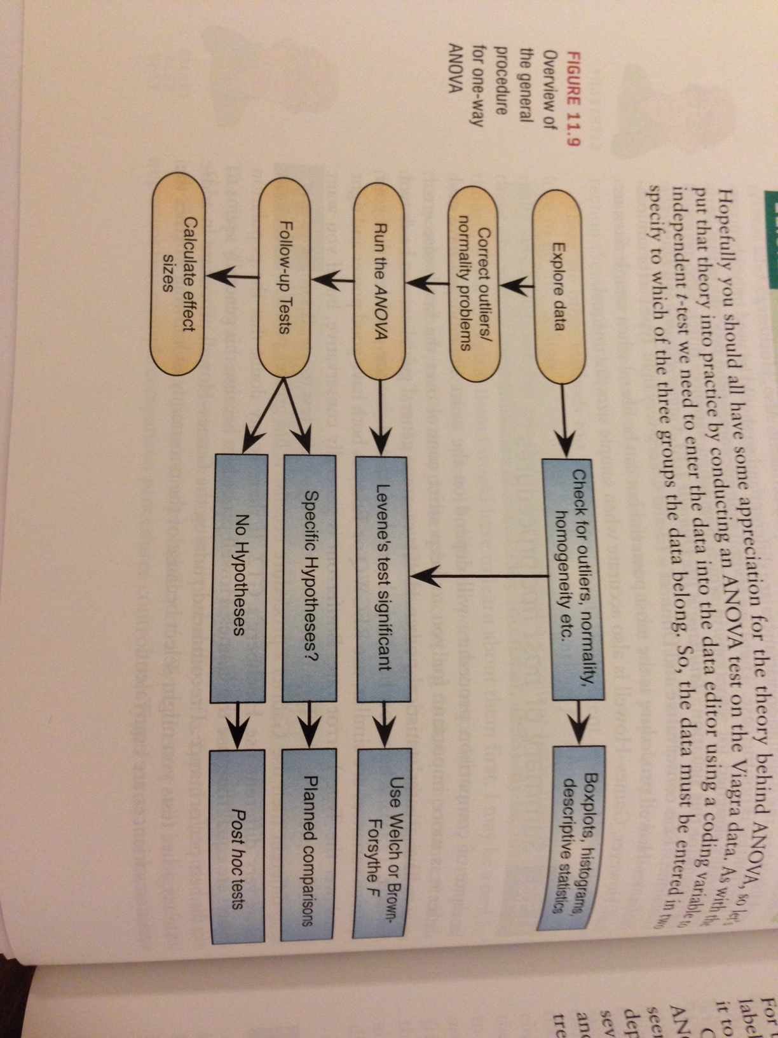
SPSS how to (pg 460)

Slide 32
SPSS
(just the main portion → we are going to talk about planned comparisons and post hoc tests in the next class, so we will be adding on to these SPSS procedures.
Two ways to get an ANOVA
If you want to do planned comparisons (contrasts only), you will want to use the One-Way ANOVA method.
Generally, most people use the General Linear Model method because it allows you to get post hoc tests and to run multiway ANOVAs.

Slide 33
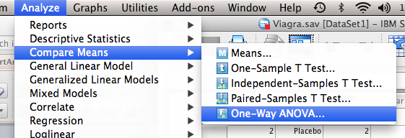
SPSS – One Way Method
Analyze > compare means > one way ANOVA

Slide 34
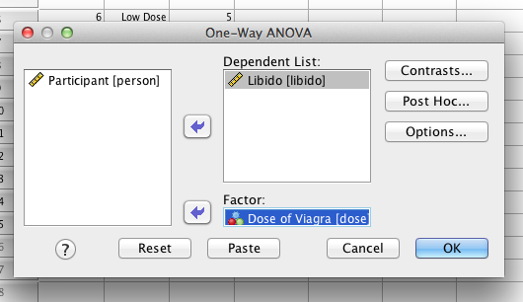
SPSS – One Way Method
Dependent list – put in your DV
Factor – put in your IV
(this should look a lot like the t-test boxes)

Slide 35
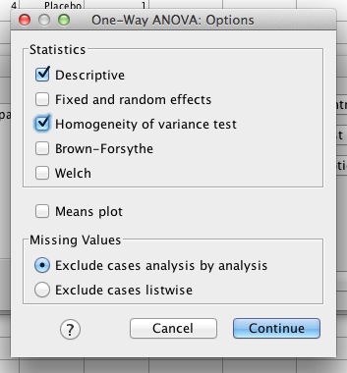
SPSS – One Way Method
Hit options
Descriptive = means
Homogeneity = Levene’s
Brown-Forsythe, Welch are
Various versions of F that
Solves some of the homogeneity
Problems…not used very
Often in psychology
Missing (first is pairwise)

Slide 36
SPSS – One Way Method
We will talk about contrasts and post hocs next time!
Hit ok!

Slide 37
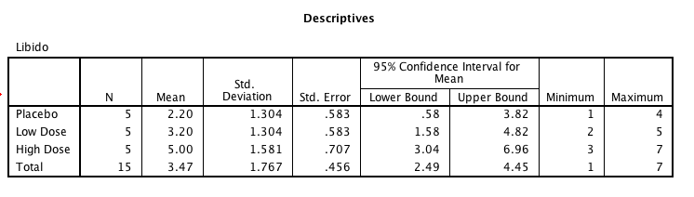
SPSS – One Way Method

Slide 38
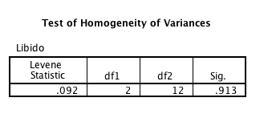
SPSS – One Way Method

Slide 39
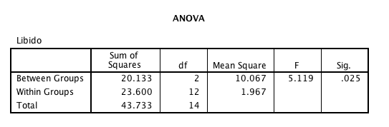
SPSS – One Way Method

Slide 40
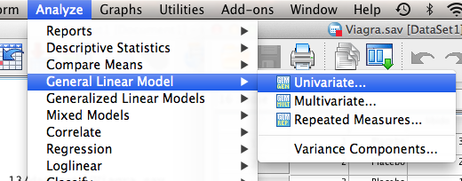
SPSS – GLM Method
Analyze > General Linear Model > Univariate

Slide 41
SPSS – GLM Method
Dependent variable = DV
Fixed factor = IV
(for now, ignore the other boxes).

Slide 42
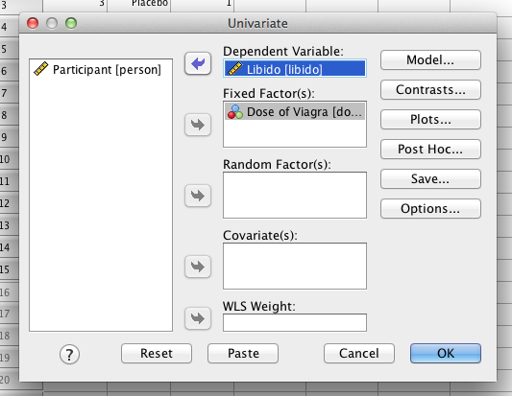
SPSS – GLM Method

Slide 43
SPSS – GLM Method
Click options
Move over your Factors and Factor Interactions
Click descriptive statistics
Click estimates of effect size (yes!!)
Click homogeneity tests
Hit continue

Slide 44
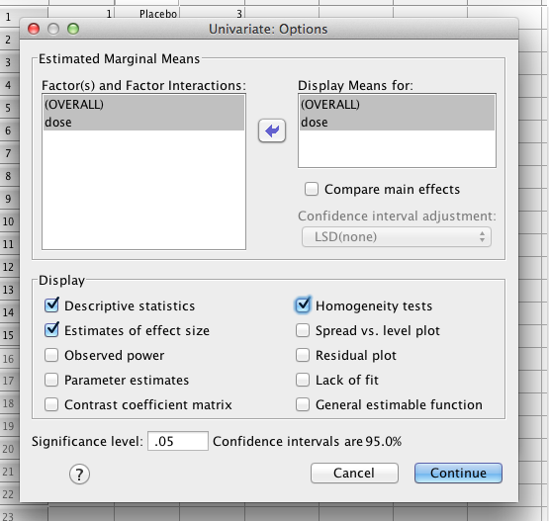
SPSS – GLM Method

Slide 45
SPSS – GLM Method
We will use post hoc tests later.
Contrasts does not quite equal planned comparisons (although sometimes people use these terms interchangeably).
Hit ok!

Slide 46
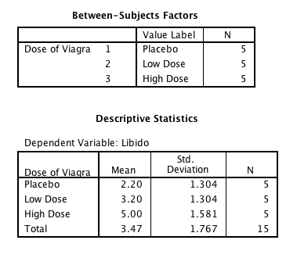
SPSS – GLM Method

Slide 47
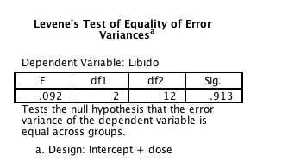
SPSS – GLM Method

Slide 48
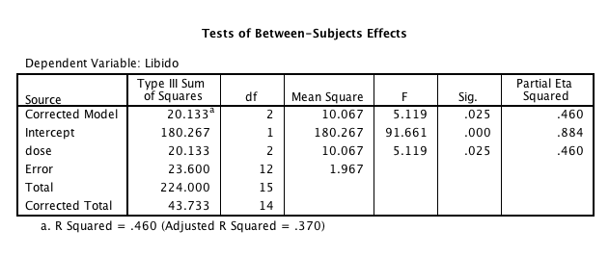
SPSS – GLM Method

Slide 49
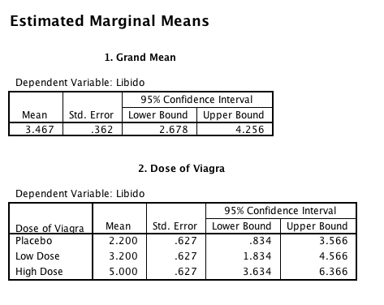
SPSS – GLM Method

Slide 50
APA – just F-test part
There was a significant effect of Viagra on levels of libido, F(2, 12) = 5.12, p = .03, n²= .46.
We will talk about Means, SD/SE as part of the post hoc test.

Slide 51
Planned Contrasts Post Hocs

Slide 52
Why Use Follow-Up Tests?
The F-ratio tells us only that the experiment was successful
i.e. group means were different
It does not tell us specifically which group means differ from which.
We need additional tests to find out where the group differences lie.

Slide 53
How?
Multiple t-tests
We saw earlier that this is a bad idea
Orthogonal Contrasts/Comparisons
Hypothesis driven
Planned a priori
Post Hoc Tests
Not Planned (no hypothesis)
Compare all pairs of means
Trend Analysis

Slide 54
Planned Contrasts
Basic Idea:
The variability explained by the Model (experimental manipulation, SS_{M}) is due to participants being assigned to different groups.
This variability can be broken down further to test specific hypotheses about which groups might differ.
We break down the variance according to hypotheses made a priori (before the experiment).
It’s like cutting up a cake (yum yum!)

Slide 55
Rules When Choosing Contrasts
Independent
contrasts must not interfere with each other (they must test unique hypotheses).
Only 2 Chunks
Each contrast should compare only 2 chunks of variation (why?).
K-1
You should always end up with one less contrast than the number of groups.

Slide 56
Generating Hypotheses
Example: Testing the effects of Viagra on Libido using three groups:
Placebo (Sugar Pill)
Low Dose Viagra
High Dose Viagra
Dependent Variable (DV) was an objective measure of Libido.
Intuitively, what might we expect to happen?

Slide 57
 | Placebo | Low Dose | High Dose
 | 3 | 5 | 7
 | 2 | 2 | 4
 | 1 | 4 | 5
 | 1 | 2 | 3
 | 4 | 3 | 6
Mean | 2.20 | 3.20 | 5.00

Slide 58
How do I Choose Contrasts?
Big Hint:
In most experiments we usually have one or more control groups.
The logic of control groups dictates that we expect them to be different to groups that we’ve manipulated.
The first contrast will always be to compare any control groups (chunk 1) with any experimental conditions (chunk 2).

Slide 59
Hypotheses
Hypothesis 1:
People who take Viagra will have a higher libido than those who don’t.
Placebo ≠ (Low, High)
Hypothesis 2:
People taking a high dose of Viagra will have a greater libido than those taking a low dose.
Low ≠ High

Slide 60
Planned Comparisons

Slide 61
Another Example

Slide 62
Another Example

Slide 63
Contrasts
When you do these combined comparisons … what are you actually comparing?
For example, the control group versus the experimental groupS
You are comparing the control group mean (2.20 in this experiment) to the experimental groups combined mean (4.10 in this experiment)
So the average experimental groups are > than the single control group

Slide 64
Coding Planned Contrasts: Rules
Rule 1
Groups coded with positive weights compared to groups coded with negative weights.
Rule 2
The sum of weights for a comparison should be zero.
Rule 3
If a group is not involved in a comparison, assign it a weight of zero.

Slide 65
Coding Planned Contrasts: Rules
Rule 4
For a given contrast, the weights assigned to the group(s) in one chunk of variation should be equal to the number of groups in the opposite chunk of variation.
Rule 5
If a group is singled out in a comparison, then that group should not be used in any subsequent contrasts.

Slide 66
Defining Contrasts Using Weights

Slide 68
Orthogonality
The variance has been evenly split – no overlap between comparisons.
How to tell?
Products of the contrast weights add up to zero
Why?
Controls type 1 error

Slide 69
Orthogonality
Group | Contrast 1 | Contrast 2 | Product
Placebo | -2 | 0 | 0
Low Dose | 1 | -1 | -1
High Dose | 1 | 1 | 1
Total | 0 | 0 | 0

Slide 70
SPSS – One Way Method
Analyze > compare means > one way ANOVA

Slide 71
SPSS – One Way Method
Dependent list – put in your DV
Factor – put in your IV
(this should look a lot like the t-test boxes)

Slide 72
SPSS – One Way Method
Hit options
Descriptive = means
Homogeneity = Levene’s
Brown-Forsythe, Welch are
Various versions of F that
Solves some of the homogeneity
Problems…not used very
Often in psychology
Missing (first is pairwise)

Slide 73
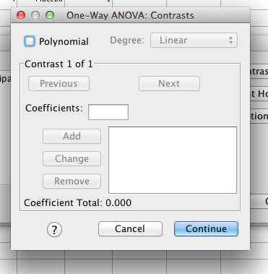
SPSS – One Way Method
Hit contrasts

Slide 74
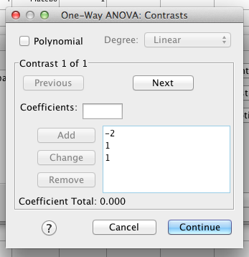
SPSS – One Way Method
Enter your contrast numbers one at a time, remembering that they go in the order of the group’s value labels.
Hit NEXT to enter a
second set of contrasts

Slide 75
Output

Slide 76
SPSS – GLM Method
Analyze > General Linear Model > Univariate

Slide 77
SPSS – GLM Method
Dependent variable = DV
Fixed factor = IV
(for now, ignore the other boxes).

Slide 78
SPSS – GLM Method

Slide 79
SPSS – GLM Method
Click options
Move over your Factors and Factor Interactions
Click descriptive statistics
Click estimates of effect size (yes!!)
Click homogeneity tests
Hit continue

Slide 80
SPSS – GLM Method

Slide 81
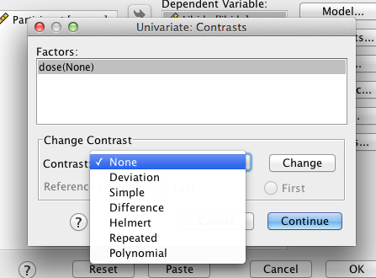
Canned Contrasts
In the GLM method of running an ANOVA, you also get contrast options.

Slide 82
Canned Contrasts
Deviation = compares each level to the combined experimental grand mean (2 vs 123)
You can chose which one you don’t want to do
First = no 1 vs 123
Last = no 3 vs 123
Simple = each category versus the others (1 vs 2)
You can pick the reference group (first or last)

Slide 83
Canned Contrasts
Repeated = each category to compared to the next category (1 vs 2, 2 vs 3)
Helmert = each category is compared to the mean effect of all subsequent categories (1 vs 23, 2 vs 3)
Difference (backwards Helmert) = (3 vs 21, 2 vs 1)

Slide 84
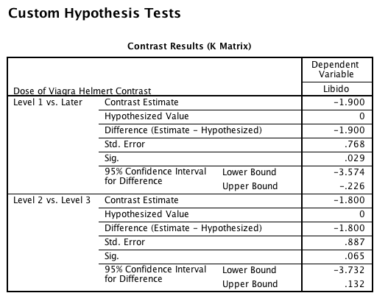
Output

Slide 85
Trend Analyses
Quadratic Trend = a curve across levels
Cubic Trend = two changes in direction of trend
Quartic Trend = three changes in direction of trend

Slide 86
Trend Analysis

Slide 87
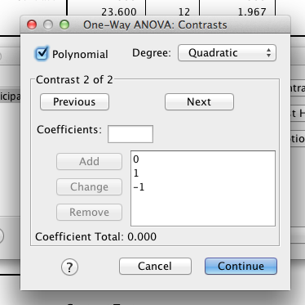
Trend Analysis – One Way
Under contrasts > click polynomial and pick which option you want to test for (remembering that you can only have so many changes as K-1)

Slide 88
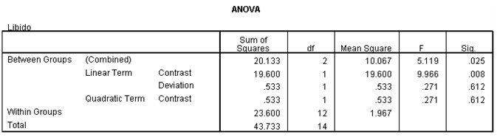
Trend Analysis: Output

Slide 89
Post Hoc Tests
Compare each mean against all others.
In general terms they use a stricter criterion to accept an effect as significant.
Please see handout!

Slide 90
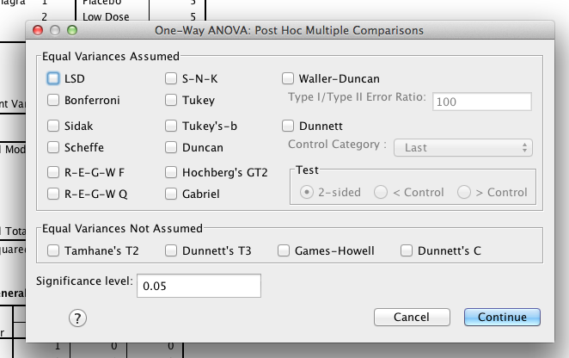
Post Hoc Tests
One way method
Click post hoc

Slide 91
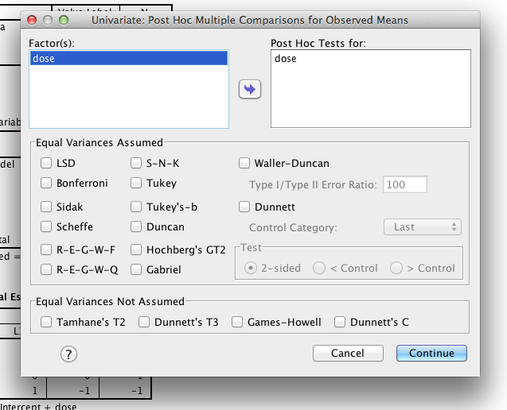
Post Hoc Tests
GLM Method
Click post hoc
Move variables over

Slide 92
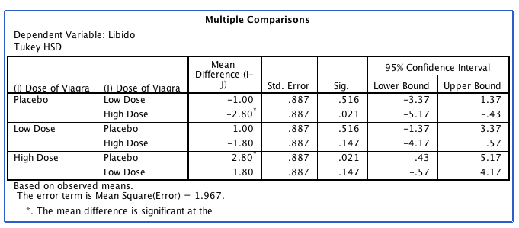
Post Hoc Output

Slide 93
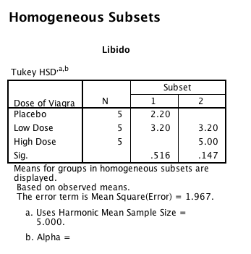
Post Hoc Output

Slide 94
Reporting Results
There was a significant effect of Viagra on levels of libido, F(2, 12) = 5.12, p = .025, ω= .60.
There was a significant linear trend, F(1, 12) = 9.97, p = .008, ω= .62, indicating that as the dose of Viagra increased, libido increased proportionately.

Slide 95
Reporting Results Continued
Planned contrasts revealed that having any dose of Viagra significantly increased libido compared to having a placebo, t(12) = 2.47, p = .029, r = .58, but having a high dose did not significantly increase libido compared to having a low dose, t(12) = 2.03, p = .065, r = .51.
Include a figure of the means! OR list the means in the paragraph.

Slide 96
Effect Size
F-test
R²
η²
ω²
Post hocs
d or partial values from above
Note most people leave these as squared unlike the book.

